Slide 1
Utilizing software to schedule an IT project.
By Antoni Chorążyczewski

Slide 2
Why do we need project scheduling software?
Without project scheduling software, the projects often fall short of missing the deadlines
Sometimes project scope might get too big, and without it is hard to notice, how much time is actually needed
It is often also useful to see the progress the project is making, it can even raise the team's morale to see the bar moving to completion

Slide 3
What is Project Scheduling Software used for?
plan tasks
assign deadlines
manage dependencies
allocate resources
track milestones
monitor critical paths

Slide 4
User Needs: What Must the Software Deliver?
Visual project timeline (Gantt Chart)
Task dependency management
Resource allocation
Deadline tracking
Team collaboration
Progress monitoring
Export reports (PDF/Excel)
Cloud access
Notifications & reminders
Free or affordable pricing

Slide 5
Functional Specifications
Functionality | Purpose | Input | Output | MoSCoW
Gantt Chart | Visualize project schedule | Tasks + dates | Timeline view | Must
Task Dependencies | Prevent scheduling conflicts | Linked tasks | Logical sequence | Must
Milestones | Track major deadlines | Milestone definition | Key delivery points | Must
Calendar View | Easy deadline overview | Tasks + dates | Calendar schedule | Should
Team Assignment | Allocate work | Team members | Assigned responsibilities | Must
Notifications | Prevent delays | Deadline changes | Alerts | Should
Comments | Improve communication | User notes | Shared feedback | Could
Progress Tracking | Monitor execution | Task status | Completion % | Must
PDF/Excel Export | Stakeholder reports | Export command | Formal reports | Should
Version History | Change tracking | Automatic logs | Audit trail | Should
Dashboard Reports | PM visibility | Live project data | KPI overview | Could

Slide 6
Software options

Slide 7
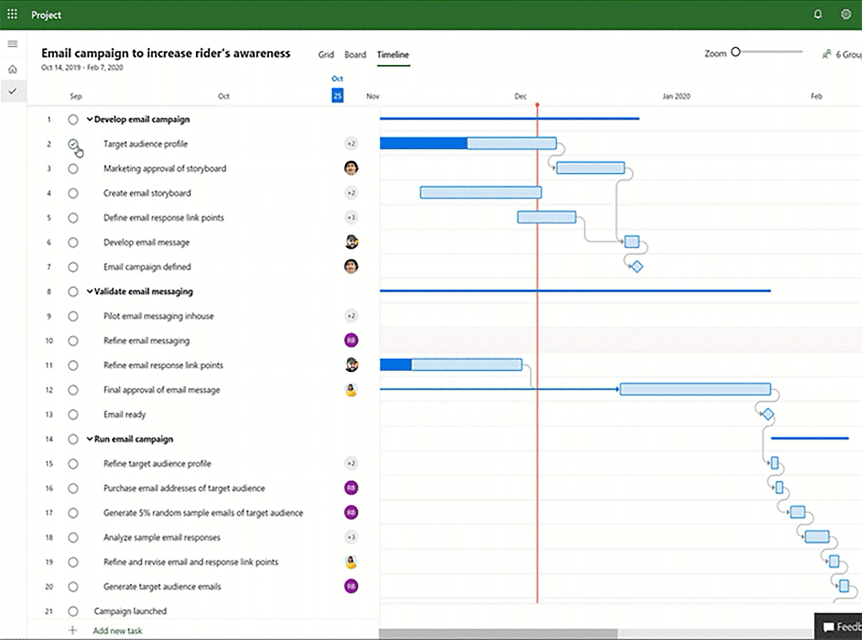
Microsoft Project
Type | Desktop + Cloud
Producer | Microsoft
Free Version | No
Premium Price | $10 - $55 per user/month Or $720-$1410 once
Main Strength | Big projects, Advanced scheduling, Critical Path, Resource planning
Main Weakness | Expensive, difficult for beginners

Slide 8
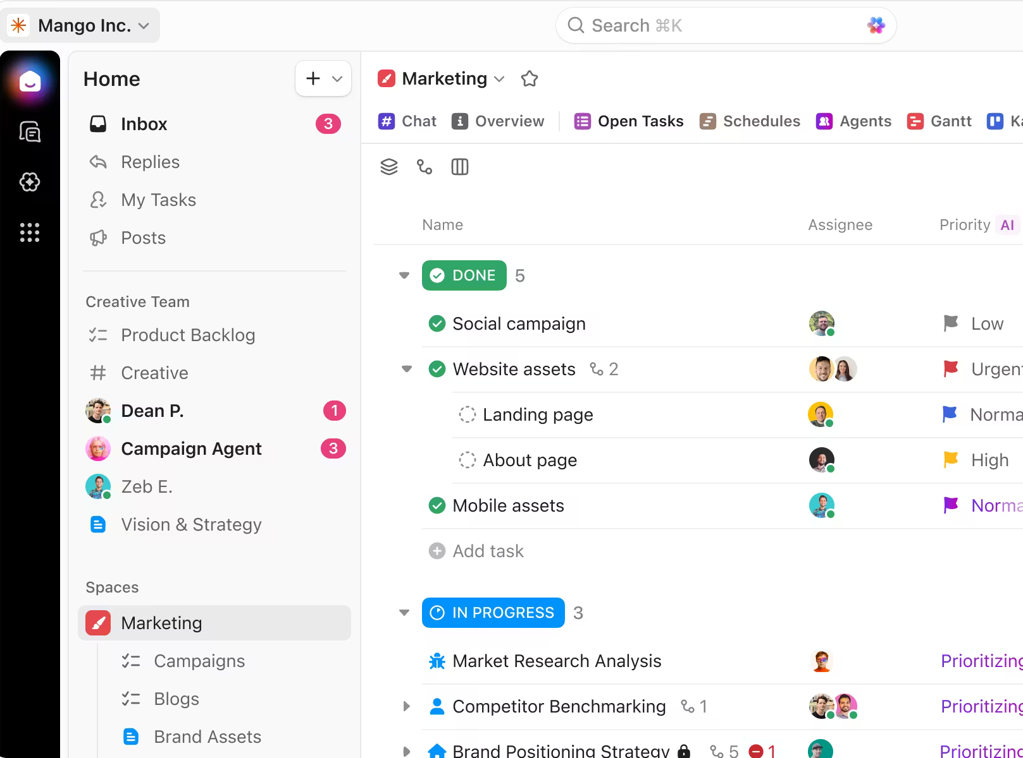
ClickUp
Type | Web Application
Producer | ClickUp Inc.
Free Version | Yes
Premium Price | $7 - $19 per user/month
Main Strength | Gantt charts, dependencies, collaboration
Main Weakness | Most of the features are paid, with a trail

Slide 9
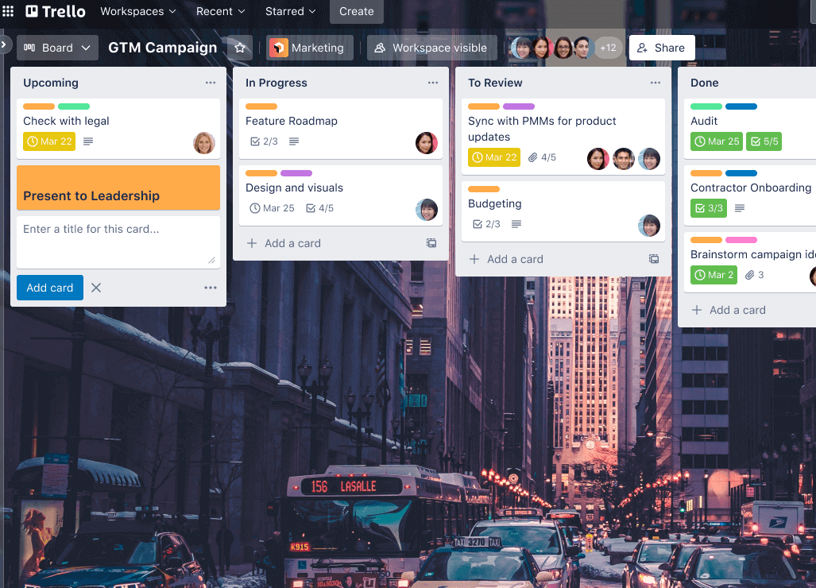
Trello
Type | Web Application
Producer | Atlassian
Free Version | Yes
Premium Price | $5 - $17.50 per user/month
Main Strength | Very simple and easy to use, powerful addons
Main Weakness | A lot of features have to be installed

Slide 10
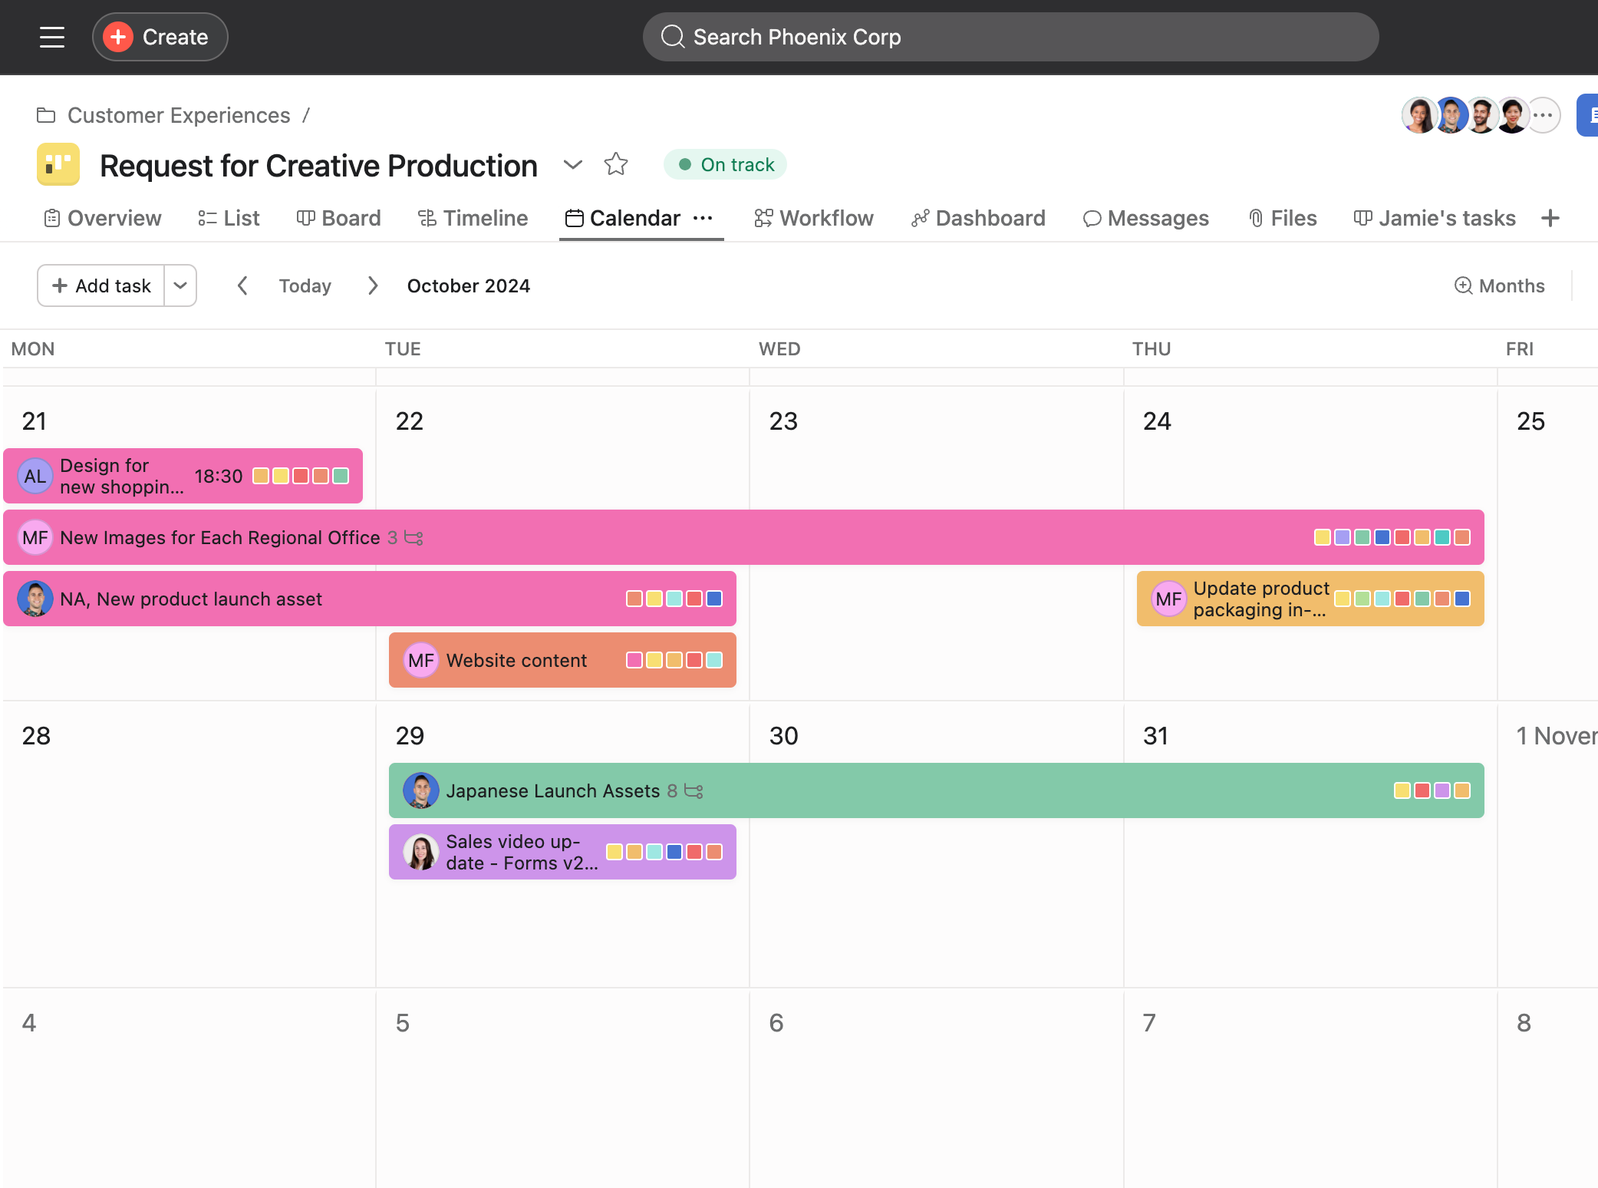
Asana
Type | Web Application
Producer | Asana Inc.
Free Version | Yes
Premium Price | $11 - $25 per user/month
Main Strength | Strong timeline and collaboration tools
Main Weakness | Timeline features limited in free plan

Slide 11
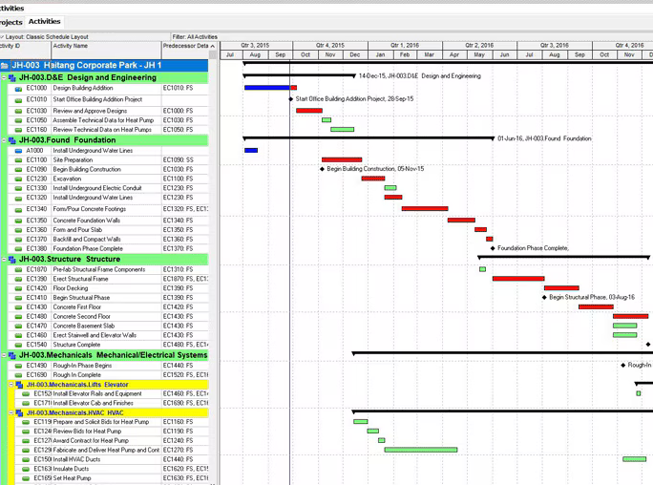
Primavera P6
Type | Desktop Application
Producer | Oracle
Free Version | No
Premium Price | $3,520 per user
Main Strength | Easier than it looks, recommended by many project managers
Main Weakness | Expensive, outdated look

Slide 12
Software options (one table)
Program Name | Type | Producer | Free Version | Premium Price | Main Strength | Main Weakness
Microsoft Project | Desktop + Cloud | Microsoft | No | $10 - $55 per user/month Or $720-$1410 once | Advanced scheduling, Critical Path, Resource planning | Expensive, difficult for beginners
ClickUp | Web Application | ClickUp Inc. | Yes | $7 - $19 per user/month | Gantt charts, dependencies, collaboration | Most of the features are paid, with a trail
Trello | Web Application | Atlassian | Yes | $5 - $17.50 per user/month | Very simple and easy to use, powerful addons | A lot of features have to be installed
Asana | Web Application | Asana Inc. | Yes | $11 - $25 per user/month | Strong timeline and collaboration tools | Timeline features limited in free plan
Primavera P6 | Desktop Application | Oracle | Trail | $3,520 per user | Easier than it looks, recommended by many project managers | Expensive, outdated look

Slide 13
Functional Comparison of Scheduling Features
Functionality | MS Project | ClickUp | Trello | Asana | Primavera P6
Gantt Chart | Whole program is paid | 60 trial uses | Power-up | Paid | Whole program is paid
Task Dependencies | Whole program is paid | Available for free | Power-up | Paid | Whole program is paid
Milestones | Whole program is paid | Available for free | Paid | Paid | Whole program is paid
Calendar View | Whole program is paid | Available for free | Paid | Available for free | Whole program is paid
Team Assignment | Whole program is paid | Limited number of teams | Available for free | 2 users for free | Whole program is paid
Notifications | Whole program is paid | Need premium to connect to google | Available for free | Available for free | Whole program is paid
Comments | Whole program is paid | Available for free | Available for free | Available for free | Whole program is paid
Progress Tracking | Whole program is paid | Available for free | Power-up | Available for free | Whole program is paid
PDF/Excel Export | Whole program is paid | Need premium to export | Power-up | Add-on (Additional payment) | Whole program is paid
Version History | Whole program is paid | Simple undo | Power-up | Simple undo | Whole program is paid
Dashboard Reports | Whole program is paid | Need premium to export | Power-up | Paid | Whole program is paid

Slide 14
Selected program for exercise - ClickUp
Best balance of features and simplicity
Real Gantt Chart support
Task dependencies and milestones
Mostly free (paid features have enough of a trail
Browser-based (no installation)
No features that require installing power-ups

Slide 15
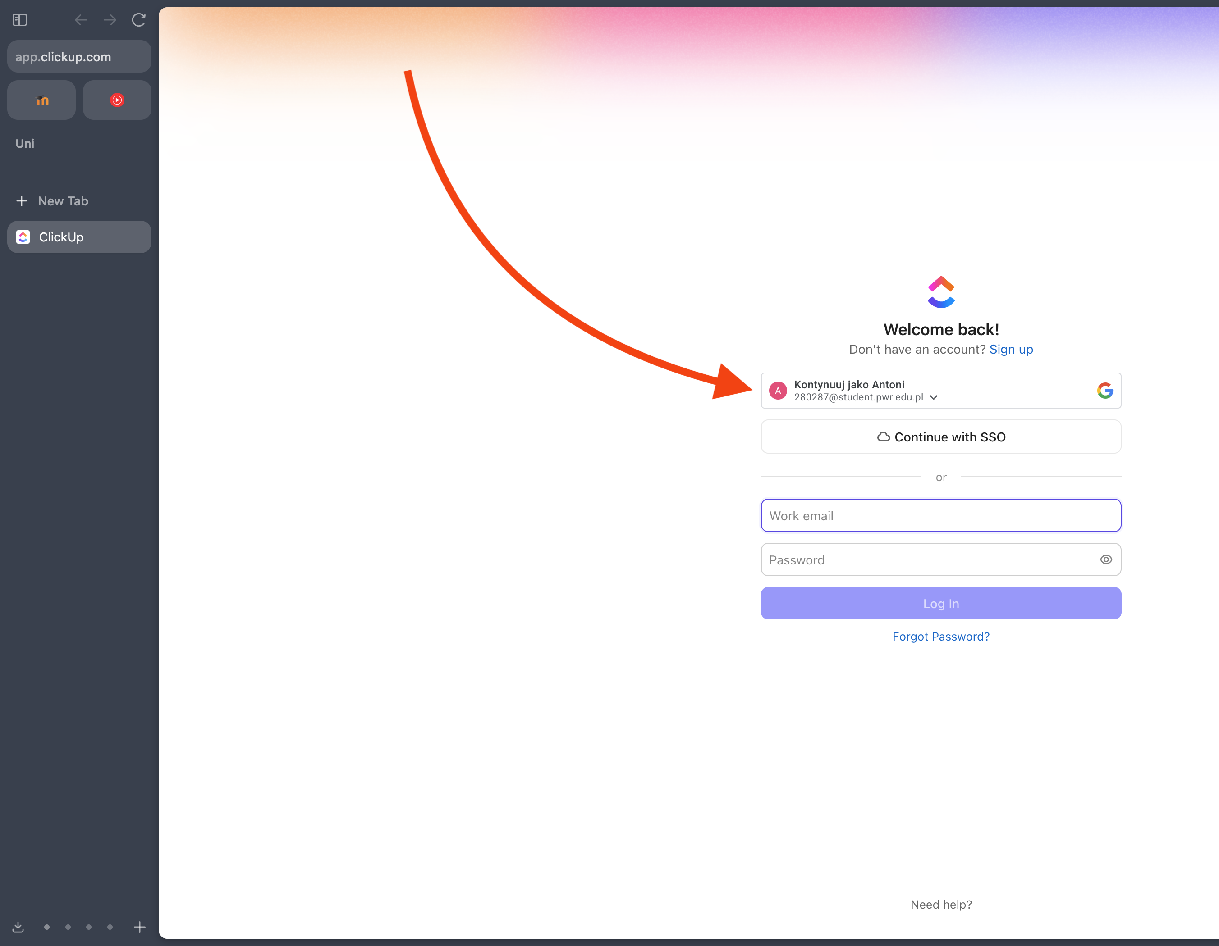
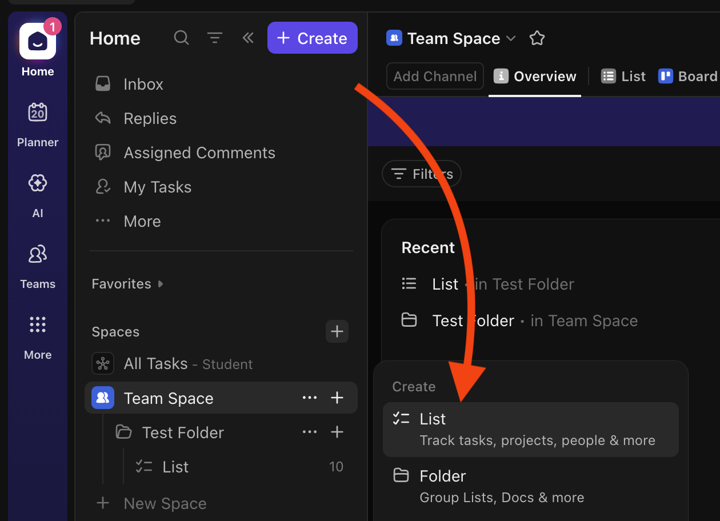
Signup + task list creation
Go to clickup.com and click signup.
Use your student google account for the sign up
Create a new task list

Slide 16
Demo exercise here

Slide 17
Exercise for you
Imagine your team has been hired to develop a small online store for a client who wants to sell products through a website. As project managers, your task is to create a realistic project schedule that helps the team deliver the project on time and avoid delays.
Minimum 8 tasks related to the development of the online store
Minimum 2 task dependencies
Minimum 2 milestones representing major project goals
Move some task to progress, some to complete

